Slide 1
Amazon Virtual Private Cloud
Dr. Noman Islam

Slide 2
Amazon Virtual Private Cloud
The Amazon Virtual Private Cloud (Amazon VPC) is a custom-defined virtual network within the AWS Cloud.
You can provision your own logically isolated section of AWS, similar to designing and implementing a separate independent network that would operate in an on-premises data center
Amazon VPC is the networking layer for Amazon Elastic Compute Cloud (Amazon EC2), and it allows you to build your own virtual network within AWS

Slide 3
You control various aspects of your Amazon VPC, including selecting your own IP address range; creating your own subnets; and configuring your own route tables, network gateways, and security settings
When you create an Amazon VPC, you must specify the IPv4 address range by choosing a Classless InterDomain Routing (CIDR) block, such as 10.0.0.0/16.

Slide 4
The address range of the Amazon VPC cannot be changed after the Amazon VPC is created.
An Amazon VPC address range may be as large as /16 (65,536 available addresses) or as small as /28 (16 available addresses) and should not overlap any other network with which they are to be connected.

Slide 5
EC-2 classic
Amazon EC2 originally launched with a single, flat network shared with other AWS customers called EC2-Classic.
As such, AWS accounts created prior to the arrival of the Amazon VPC service can launch instances into the EC2-Classic network and EC2-VPC.
AWS accounts created after December 2013 only support launching instances using EC2-VPC.
AWS accounts that support EC2-VPC will have a default VPC created in each region with a default subnet created in each Availability Zone.
The assigned CIDR block of the VPC will be 172.31.0.0/16.

Slide 6
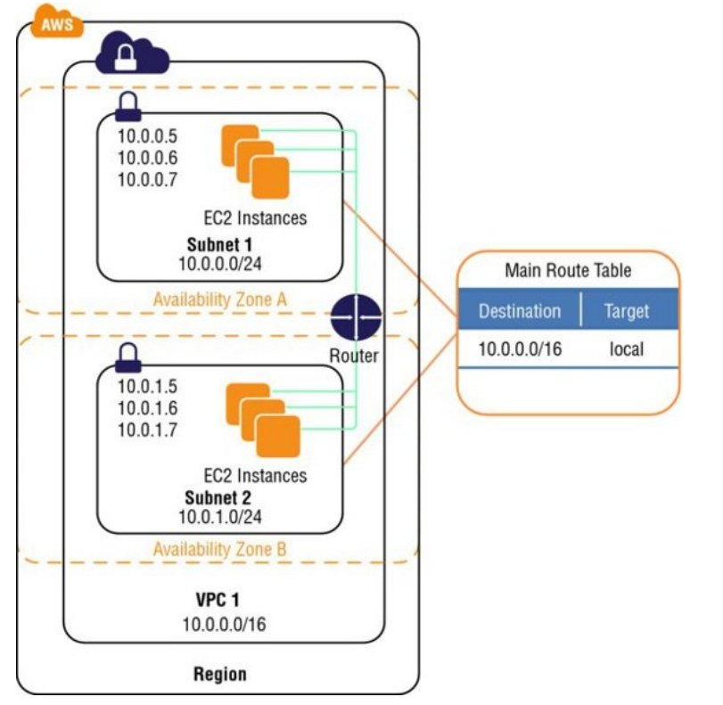

Slide 7
Components of Amazon VPC
Subnets
Route tables
Dynamic Host Configuration Protocol (DHCP) option sets
Security groups
Network Access Control Lists (ACLs)

Slide 8
Optional components
Internet Gateways (IGWs)
Elastic IP (EIP) addresses
Elastic Network Interfaces (ENIs)
Endpoints
Peering
Network Address Translation (NATs) instances and NAT gateway
Virtual Private Gateway (VPG), Customer Gateways (CGWs), and Virtual Private Networks (VPNs)

Slide 9
Subnet
A subnet is a segment of an Amazon VPC’s IP address range where you can launch Amazon EC2 instances, Amazon Relational Database Service (Amazon RDS) databases, and other AWS resources.
The smallest subnet that you can create is a /28 (16 IP addresses)
AWS reserves the first four IP addresses and the last IP address of every subnet for internal networking purposes.
For example, a subnet defined as a /28 has 16 available IP addresses; subtract the 5 IPs needed by AWS to yield 11 IP addresses for your use within the subnet.

Slide 10
After creating an Amazon VPC, you can add one or more subnets in each Availability Zone.
Subnets reside within one Availability Zone and cannot span zones.

Slide 11
Types of subnets
Subnets can be classified as public, private, or VPN-only.
A public subnet is one in which the associated route table (discussed later) directs the subnet’s traffic to the Amazon VPC’s IGW
A private subnet is one in which the associated route table does not direct the subnet’s traffic to the Amazon VPC’s IGW.
A VPN-only subnet is one in which the associated route table directs the subnet’s traffic to the Amazon VPC’s VPG (discussed later) and does not have a route to the IGW.

Slide 12
Route tables
A route table is a logical construct within an Amazon VPC that contains a set of rules (called routes) that are applied to the subnet and used to determine where network traffic is directed.
You can modify route tables and add your own custom routes. You can also use route tables to specify which subnets are public (by directing Internet traffic to the IGW) and which subnets are private (by not having a route that directs traffic to the IGW).
Each route table contains a default route called the local route, which enables communication within the Amazon VPC, and this route cannot be modified or removed.

Slide 13
Points to remember
Your VPC has an implicit router.
Your VPC automatically comes with a main route table that you can modify.
You can create additional custom route tables for your VPC. Each subnet must be associated with a route table, which controls the routing for the subnet.
If you don’t explicitly associate a subnet with a particular route table, the subnet uses the main route table.
You can replace the main route table with a custom table that you’ve created so that each new subnet is automatically associated with it.

Slide 14
Each route in a table specifies a destination CIDR and a target; for example, traffic destined for 172.16.0.0/12 is targeted for the VPG. AWS uses the most specific route that matches the traffic to determine how to route the traffic.

Slide 15
Internet gateways
An Internet Gateway (IGW) is a horizontally scaled, redundant, and highly available Amazon VPC component that allows communication between instances in your Amazon VPC and the Internet.
An IGW provides a target in your Amazon VPC route tables for Internet-routable traffic, and it performs network address translation for instances that have been assigned public IP addresses.
Amazon EC2 instances within an Amazon VPC are only aware of their private IP addresses.

Slide 16
When traffic is sent from the instance to the Internet, the IGW translates the reply address to the instance’s public IP address (or EIP address, covered later) and maintains the one-to-one map of the instance private IP address and public IP address.
When an instance receives traffic from the Internet, the IGW translates the destination address (public IP address) to the instance’s private IP address and forwards the traffic to the Amazon VPC.

Slide 17
Create a subnet with internet
Attach an IGW to your Amazon VPC.
Create a subnet route table rule to send all non-local traffic (0.0.0.0/0) to the IGW.
Configure your network ACLs and security group rules to allow relevant traffic to flow to and from your instance.

Slide 18
Dynamic Host Configuration Protocol (DHCP) Option Sets
Dynamic Host Configuration Protocol (DHCP) provides a standard for passing configuration information to hosts on a TCP/IP network.
Some of those parameters are the domain name, domain name server, and the netbios-node-type
AWS automatically creates and associates a DHCP option set for your Amazon VPC upon creation and sets two options: domain-name-servers (defaulted to AmazonProvidedDNS) and domain-name (defaulted to the domain name for your region).
To assign your own domain name to your instances, create a custom DHCP option set and assign it to your Amazon VPC

Slide 19
DHCP Configuration
domain-name-servers—The IP addresses of up to four domain name servers, separated by commas. The default is AmazonProvidedDNS.
domain-name—Specify the desired domain name here (for example, mycompany.com).
ntp-servers—The IP addresses of up to four Network Time Protocol (NTP) servers, separated by commas
netbios-name-servers—The IP addresses of up to four NetBIOS name servers, separated by commas
netbios-node-type—Set this value to 2

Slide 20
Elastic IP address
AWS maintains a pool of public IP addresses in each region and makes them available for you to associate to resources within your Amazon VPCs.
An Elastic IP Addresses (EIP) is a static, public IP address in the pool for the region that you can allocate to your account (pull from the pool) and release (return to the pool).
EIPs allow you to maintain a set of IP addresses that remain fixed while the underlying infrastructure may change over time

Slide 21
Points to remember
You must first allocate an EIP for use within a VPC and then assign it to an instance.
EIPs are specific to a region (that is, an EIP in one region cannot be assigned to an instance within an Amazon VPC in a different region).
There is a one-to-one relationship between network interfaces and EIPs.
You can move EIPs from one instance to another, either in the same Amazon VPC or a different Amazon VPC within the same region.
EIPs remain associated with your AWS account until you explicitly release them.
There are charges for EIPs allocated to your account, even when they are not associated with a resource.

Slide 22
Elastic Network Interfaces (ENIs)
An Elastic Network Interface (ENI) is a virtual network interface that you can attach to an instance in an Amazon VPC.
ENIs are only available within an Amazon VPC, and they are associated with a subnet upon creation
Assigning a second network interface to an instance via an ENI allows it to be dual-homed

Slide 23
Endpoints
An Amazon VPC endpoint enables you to create a private connection between your Amazon VPC and another AWS service without requiring access over the Internet or through a NAT instance, VPN connection, or AWS Direct Connect
You can create multiple endpoints for a single service, and you can use different route tables to enforce different access policies from different subnets to the same service.

Slide 24
Configure a service
Specify the Amazon VPC. Specify the service. A service is identified by a prefix list of the form com.amazonaws.. .
Specify the policy.
You can allow full access or create a custom policy. This policy can be changed at any time.
Specify the route tables. A route will be added to each specified route table, which will state the service as the destination and the endpoint as the target.

Slide 25
Peering
An Amazon VPC peering connection is a networking connection between two Amazon VPCs that enables instances in either Amazon VPC to communicate with each other as if they are within the same network.
You can create an Amazon VPC peering connection between your own Amazon VPCs or with an Amazon VPC in another AWS account within a single region.

Slide 26
Peering connections are created through a request/accept protocol.
The owner of the requesting Amazon VPC sends a request to peer to the owner of the peer Amazon VPC.
If the peer Amazon VPC is within the same account, it is identified by its VPC ID.
If the peer VPC is within a different account, it is identified by Account ID and VPC ID.
The owner of the peer Amazon VPC has one week to accept or reject the request to peer with the requesting Amazon VPC before the peering request expires

Slide 27
Security groups
A security group is a virtual stateful firewall that controls inbound and outbound network traffic to AWS resources and Amazon EC2 instances.
All Amazon EC2 instances must be launched into a security group.
If a security group is not specified at launch, then the instance will be launched into the default security group for the Amazon VPC.

Slide 28
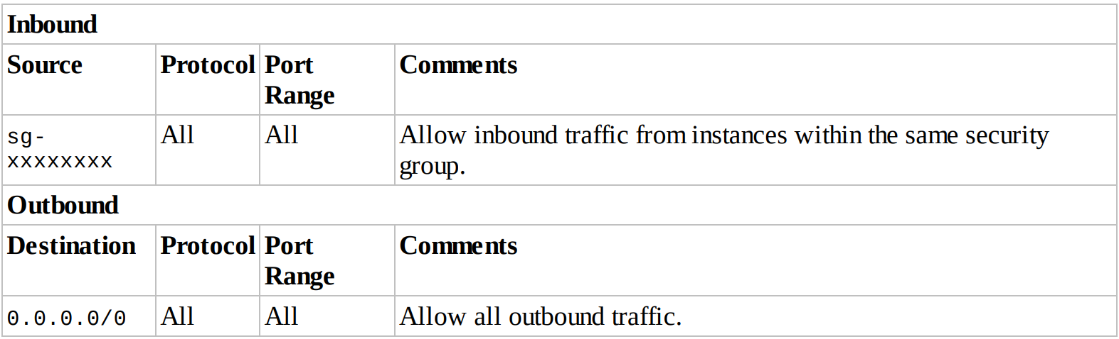

Slide 29
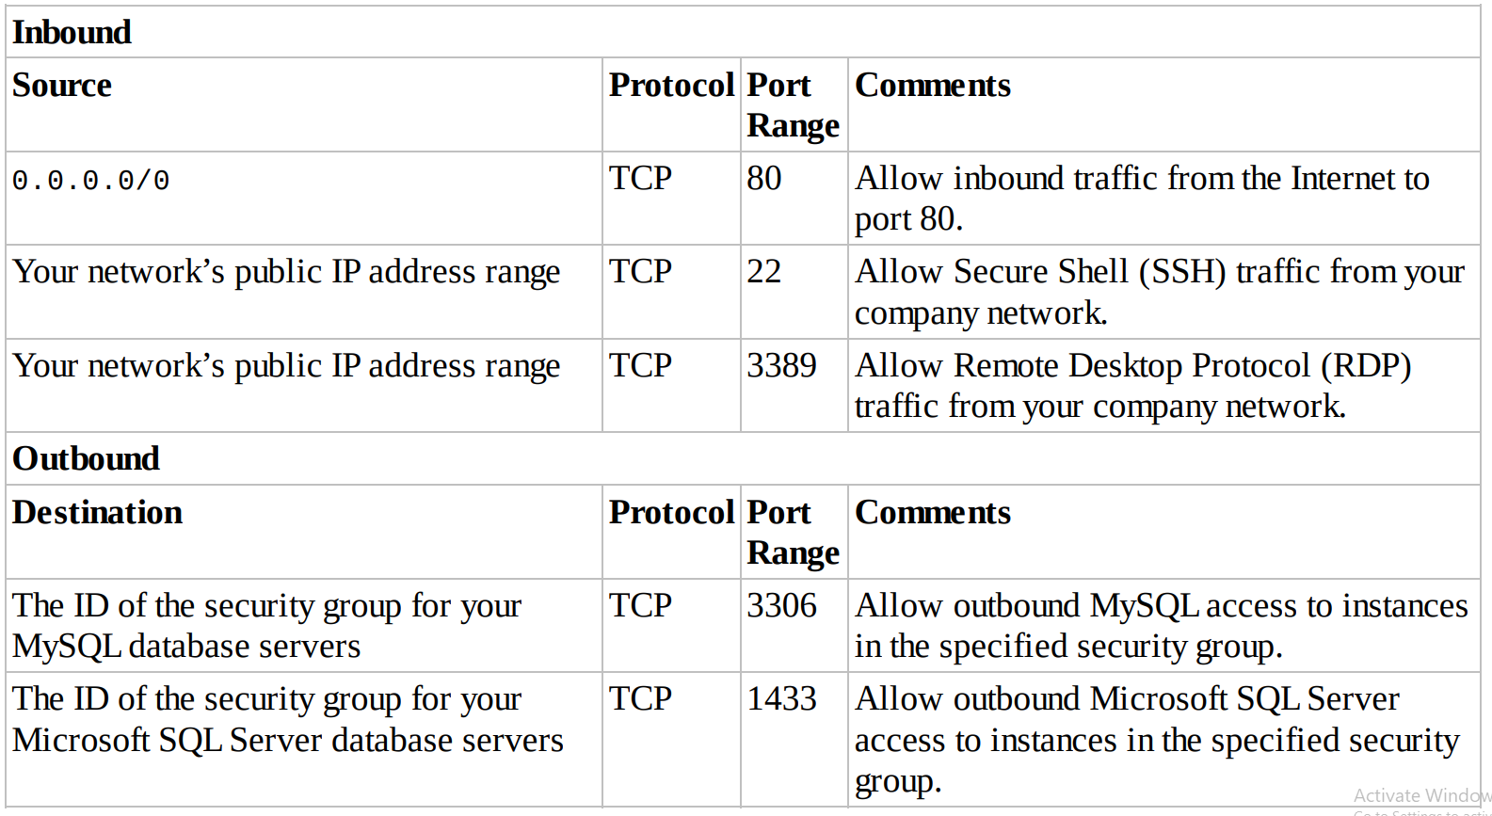

Slide 30
You can create up to 500 security groups for each Amazon VPC. You can add up to 50 inbound and 50 outbound rules to each security group. If you need to apply more than 100 rules to an instance, you can associate up to five security groups with each network interface.
You can specify allow rules, but not deny rules. This is an important difference between security groups and ACLs. You can specify separate rules for inbound and outbound traffic. By default, no inbound traffic is allowed until you add inbound rules to the security group. By default, new security groups have an outbound rule that allows all outbound traffic.

Slide 31
You can remove the rule and add outbound rules that allow specific outbound traffic only. Security groups are stateful. This means that responses to allowed inbound traffic are allowed to flow outbound regardless of outbound rules and vice versa.
This is an important difference between security groups and network ACLs. Instances associated with the same security group can’t talk to each other unless you add rules allowing it (with the exception being the default security group). You can change the security groups with which an instance is associated after launch, and the changes will take effect immediately.

Slide 32
Network Access Control Lists (ACLs)
A network access control list (ACL) is another layer of security that acts as a stateless firewall on a subnet level.
A network ACLis a numbered list of rules that AWS evaluates in order, starting with the lowest numbered rule, to determine whether traffic is allowed in or out of any subnet associated with the network ACL.
When you create a custom network ACL, its initial configuration will deny all inbound and outbound traffic until you create rules that allow otherwise

Slide 33
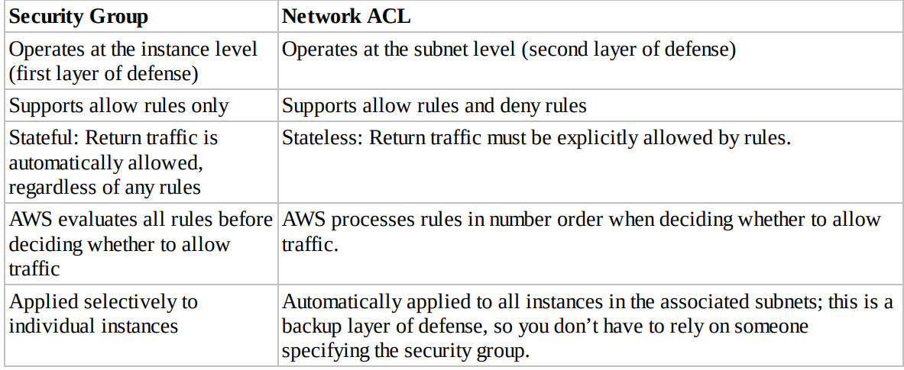

Slide 34
Network Address Translation (NAT) Instances and NAT Gateways
By default, any instance that you launch into a private subnet in an Amazon VPC is not able to communicate with the Internet through the IGW
AWS provides NAT instances and NAT gateways to allow instances deployed in private subnets to gain Internet access

Slide 35
NAT instance
A network address translation (NAT) instance is an Amazon Linux Amazon Machine Image (AMI) that is designed to accept traffic from instances within a private subnet, translate the source IP address to the public IP address of the NAT instance, and forward the traffic to the IGW.
In addition, the NAT instance maintains the state of the forwarded traffic in order to return response traffic from the Internet to the proper instance in the private subnet.
These instances have the string amzn-ami-vpc-nat in their names, which is searchable in the Amazon EC2 console.

Slide 36
NAT Gateway
A NAT gateway is an Amazon managed resource that is designed to operate just like a NAT instance, but it is simpler to manage and highly available within an Availability Zone.

Slide 37
Virtual Private Gateways (VPGs), Customer Gateways (CGWs), and Virtual Private Networks (VPNs)
You can connect an existing data center to Amazon VPC using either hardware or software VPN connections, which will make Amazon VPC an extension of the data center.
Amazon VPC offers two ways to connect a corporate network to a VPC: VPG and CGW

Slide 38
A virtual private gateway (VPG) is the virtual private network (VPN) concentrator on the AWS side of the VPN connection between the two networks.
A customer gateway (CGW) represents a physical device or a software application on the customer’s side of the VPN connection.
After these two elements of an Amazon VPC have been created, the last step is to create a VPN tunnel.
The VPN tunnel is established after traffic is generated from the customer’s side of the VPN connection

